Slide 1
Home Automation
With raspberry pi

Slide 2
Project Components
PIR Sensor
Temperature Sensor (dht22)
Bunch of led,s
Buzzer
Raspberry pi 2

Slide 3
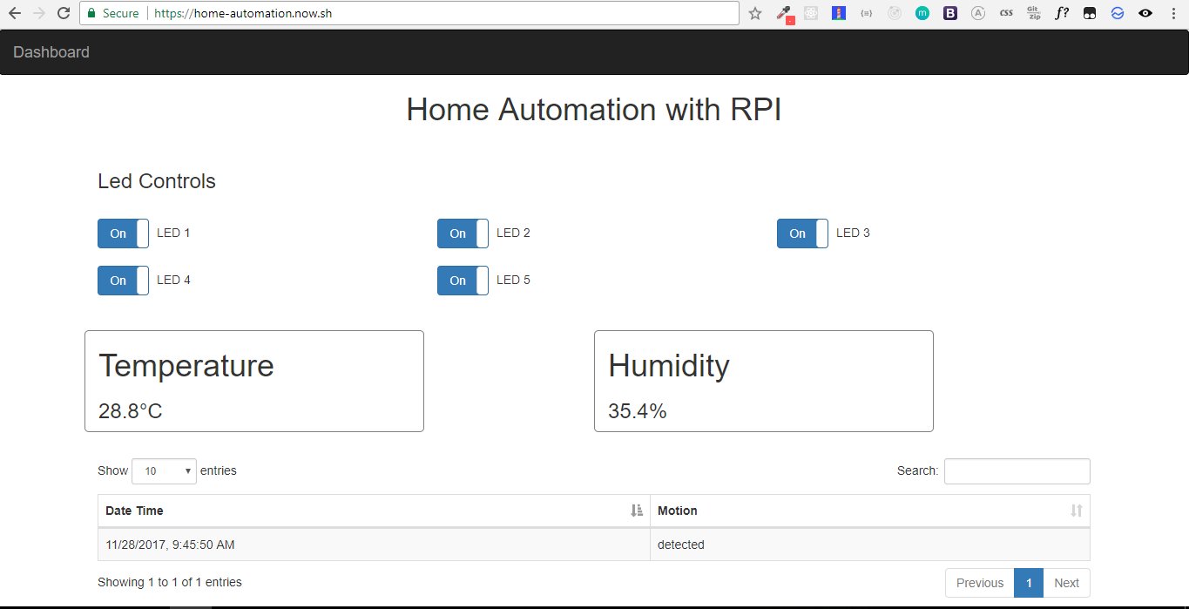
How it Works ? (Project Flow)

Slide 4
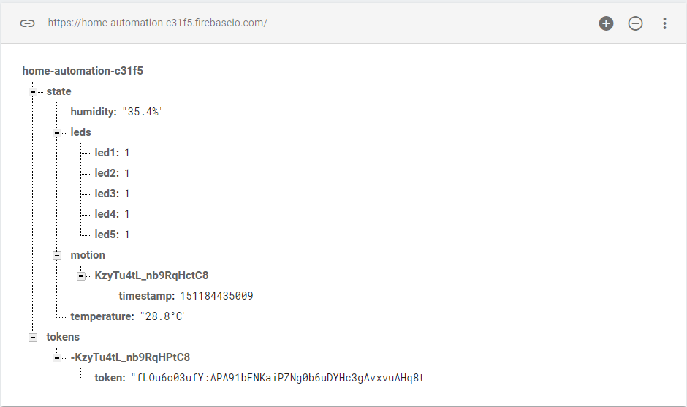
Firebase (Database)

Slide 5
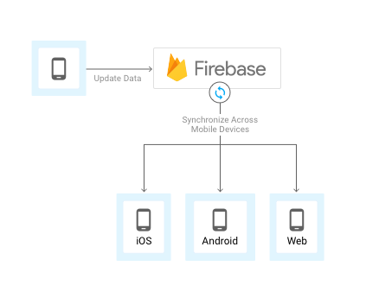

Slide 6
Prerequisite for Code
Linux Command
uname –m
Output
Armv7l
ARM, originally Acorn RISC Machine, later Advanced RISC Machine, is a family of reduced instruction set computing (RISC) architectures for computer processors
32-bit
This machine architecture can support node 8.9.1 binaries

Slide 7
Libraries (Node)
Express js (for server)
onoff (for rpi gpio in nodejs)
node-dht-sensor (specific for dht sensor in node js)
firebase-admin (firebase sdk for nodejs)

Slide 8
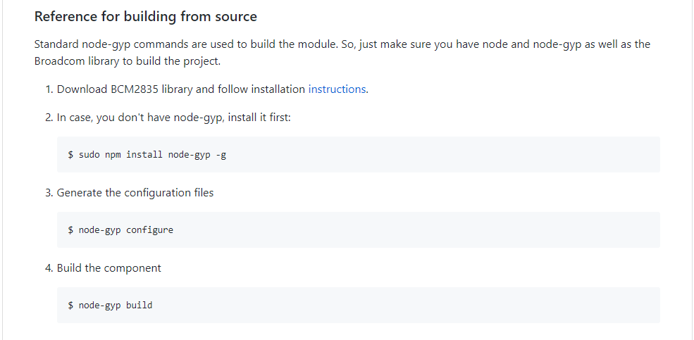
Prerequisite for node-dht-sensor

Slide 9
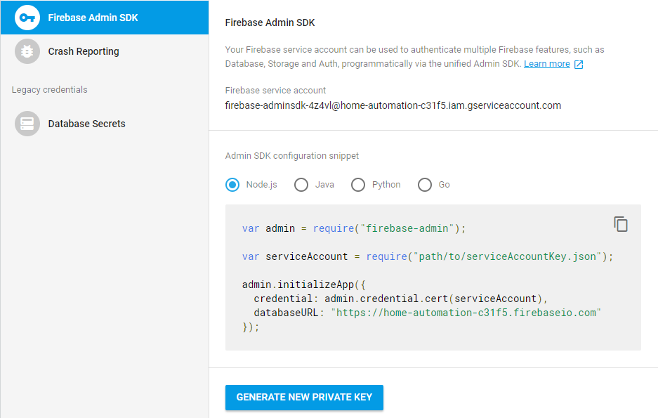
Prerequisite for firebase-admin

